Slide 1

Christiawan/13214133
Bayu Aji Sahar/13214131
Azel Fayyad R/13214108
Sistem Keamanan Mesin ATM menggunakan Sidik Jari
TA171801007

Slide 2
FITUR Sidik jari
Fitur pengenalan sidik jari dibagi menurut A. K. Jain dibagi menjadi 3 level yaitu [A. K. Jain. Learning Fingerprint Reconstruction: From Minutiae to Image. Fellew, 2015]
LEVEL 1
LEVEL 2
LEVEL 3

Slide 3
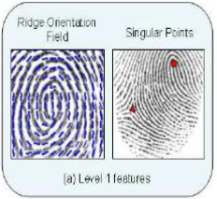
FITUR Level 1
Level 1 meliputi fitur umum dari pengenalan sidik jari, yaitu meliputi jenis pola, orientasi dari ridge dan frequency fields serta singular points

Slide 4
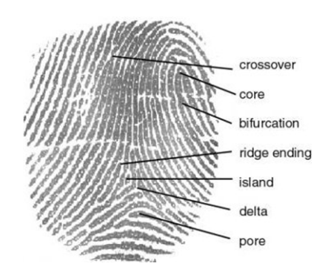
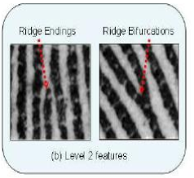
FITUR LEVEL 2
Level 2 mengacu pada pengenalan minutia poin (minutiae) pada local rigion. Pada fitur ini, jenis minutiae yang paling sering dipakai adalah ridge bifurcation dan ridge ending.

Slide 5
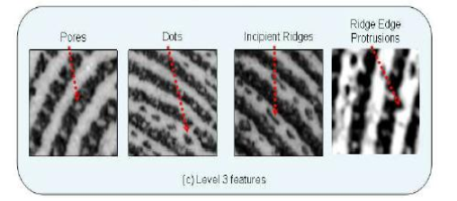
FITUR Level 3
Meliputi skala yang lebih detail, seperti lebar, ukuran, kelengkungan , countur dari ridge, pori-pori, incipient ridges, dan detail permanent

Slide 6
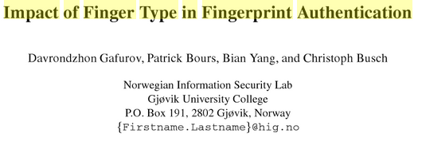
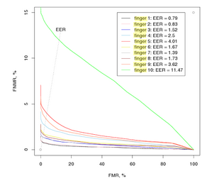
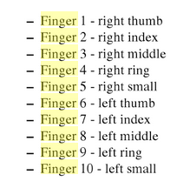
BEST FINGER TYPE
FALSE MATCH RATE (FMR) vs FALSE NON MATCH RATE (FNMR)
EER = Equal error rate

Slide 7
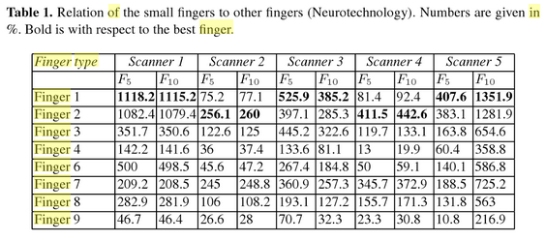
Highest eer = little finger

Slide 8
FINGERPRINT MATCHING METHOD
Menurut paper [Dr. Neeraj Bhargava. Fingerprint Recognition Using Minutia Matching. International Journal of Computer Trends and Technology- volume3Issue4- 2012]
Pattern based
Minutiae based
Correlation based

Slide 9
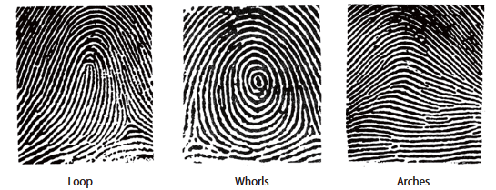
Pattern based matching
Pattern based technique compare the basic fingerprint patterns (arch, whorl, and loop) between a previously stored template and a candidate fingerprint. This requires that the images be aligned in the same orientation. In a pattern-based algorithm, the template contains the type, size, and orientation of patterns within the aligned fingerprint image. The candidate fingerprint image is graphically compared with the template to determine the degree to which they match
60-65%
30-35%
5%

Slide 10
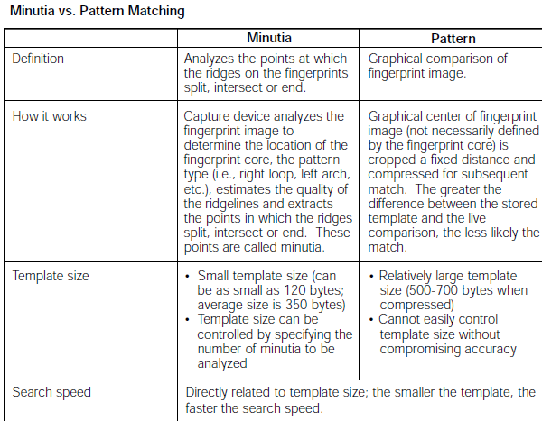
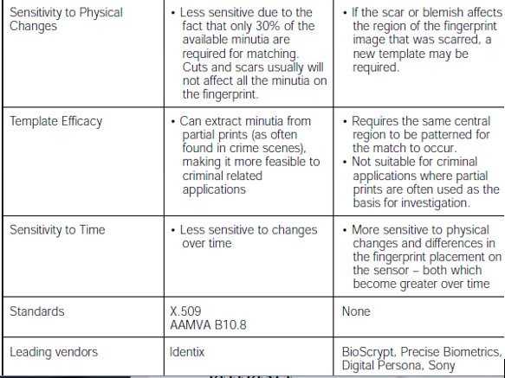

Slide 11
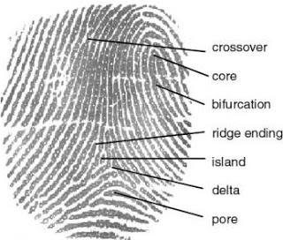
Minutia based matching
[Mr. Mahesh A. ATM Transaction Using Biometric Fingerprint Technology. International Journal of Electronics, Communication & Soft Computing Science and Engineering
ISSN: 2277-9477, Volume 2, Issue 6]
In minutiae-based techniques first of all we find minutiae points on which we have to do mapping. However, there are some difficulties when using this approach. It is difficult to identify the minutiae points accurately when the fingerprint is of low quality.
A good fingerprint contains 25 to 80 minutiae points

Slide 12
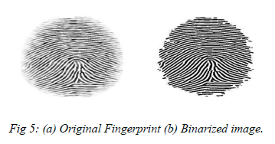
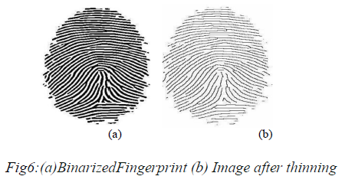
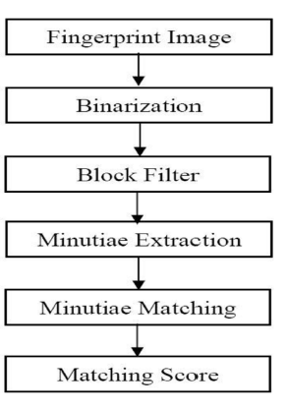
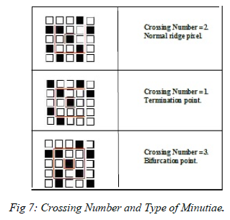
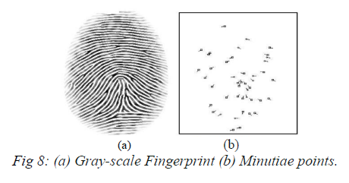
Algorithm minutia based

Slide 13
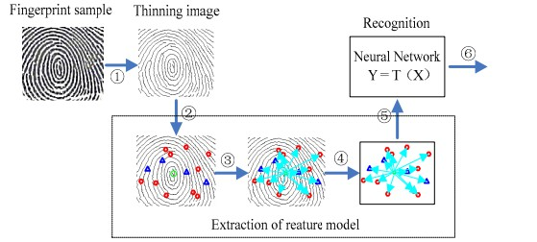

Slide 14
Correlation based matching
[Asker M. Bazen. A Correlation-Based Fingerprint Verication System. University of Twente, Department of Electrical Engineering]
Instead of only using the minutiae locations, our method directly uses the gray-level information from the ngerprint image, since a gray-level
ngerprint image contains much richer, more discriminatory, information than only the minutiae locations. Those locations only characterize a small part of the local ridge-valley structures
In correlation based matching the two fingerprint images are matched through corresponding pixels which is computed for different alignments and rotations. The main disadvantage of correlation based matching is its computational complexity.

Slide 15
Algorithm correlation based
Template Selection
Template Matching
Classification of Template Position
The template is shifted pixelwise over the secondaryprint
The fingerprint matching algorithm, based on twosets of template positions, uses two decision stages.First, elementary decisions are made by classifying theindividual template position pairs to be matching or not. Then, the information of all template pairs is merged in order to make a final decision whether theprimary and secondary fingerprint match or not.
templates are selected by checking how well they fit at other locations in the same fingerprint
At each position, the gray-level distance betweenthe template and the corresponding area inthe secondary print is determined by summing thesquared gray-level di_erences for each pixel in thetemplate.

Slide 16
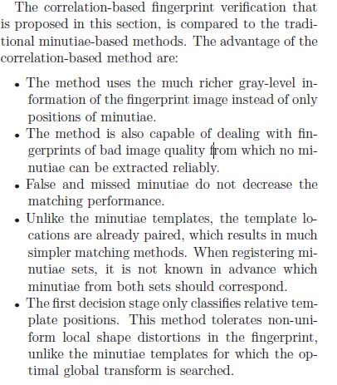

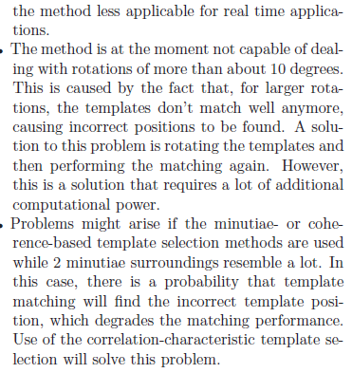

Slide 17
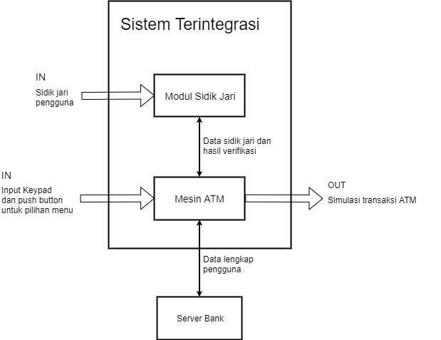
Desain level 0

Slide 18
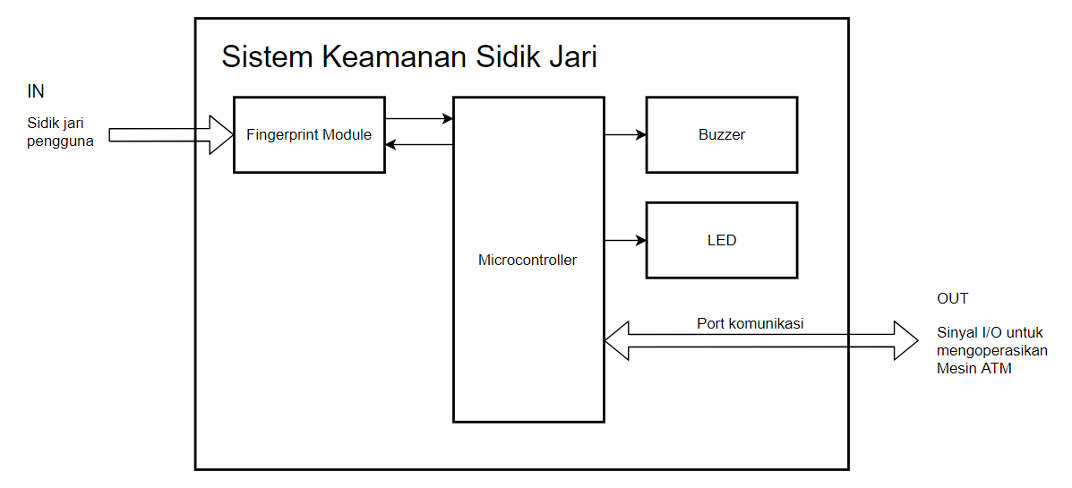
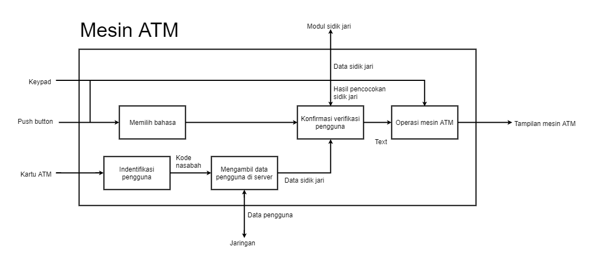
Desain level 1

Slide 19
Desain level 1

Slide 20
To do list
Pattern based recognition data and algorithm
Desain level 2
Data flow diagram
Flowchart
Neural network algorithm
Alternatif hardware design and user interface
Pilihan komponen

